Slide 1

TEAM:
CODE BEGINNER
TEAM MEMBER:
VAISHNAVI. B (LEADER)
SHARANYA
SHRADHA.B.PATIL

Slide 2

PROBLEM STATEMENT:
Marine ecosystems are affected by pollution, biodiversity loss, and overuse of resources. Many tourists, fishermen, students, and local residents notice these problems, but there is no simple platform where they can report issues or participate in environmental activities. This leads to delayed action and lack of public involvement in protecting marine ecosystems.

Slide 3
SOLUTION:
Develop an Awareness & Reporting Mobile App that allows users to report marine environmental issues using text or images. The app will also connect volunteers for beach cleaning and awareness programs. This platform encourages public participation and helps authorities identify and solve environmental problems faster.

Slide 4
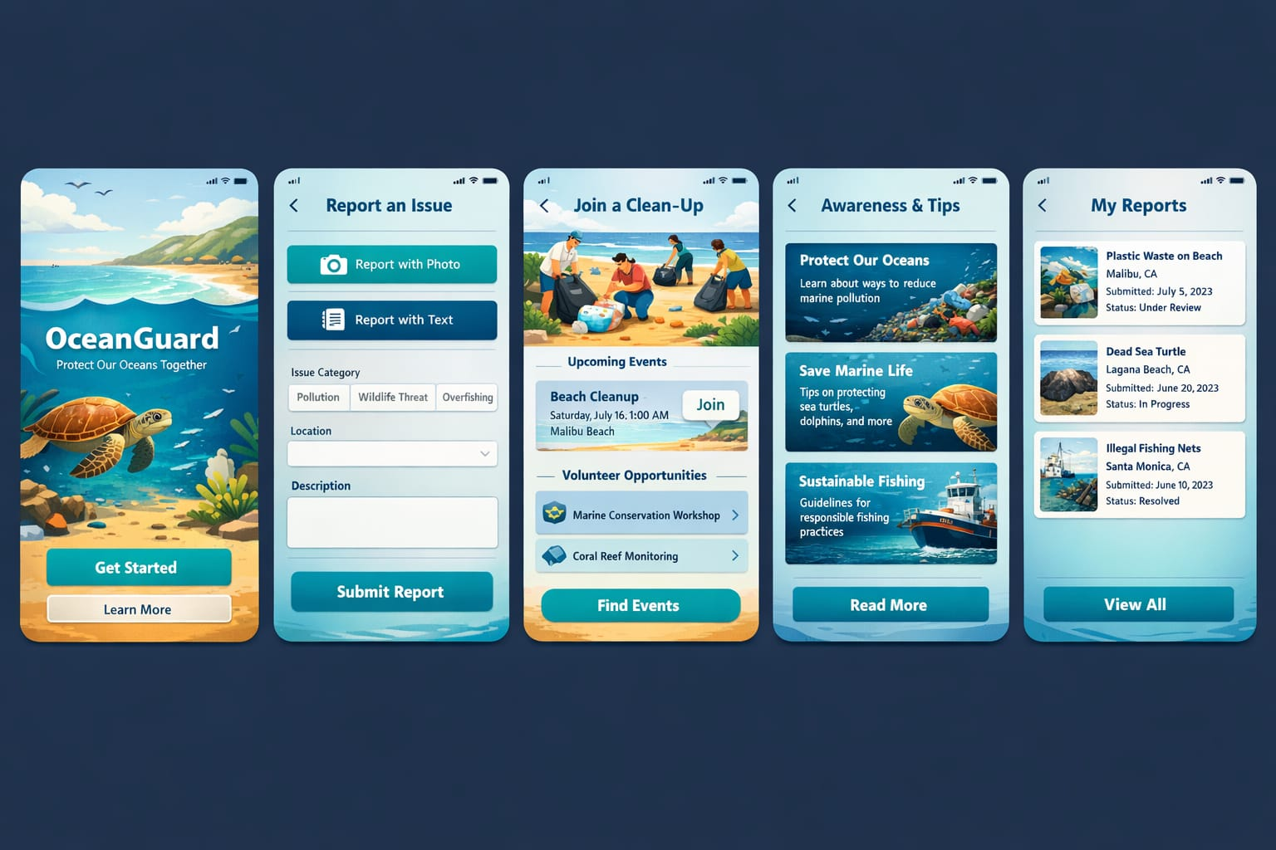
PROTOTYPE (model):

Slide 5
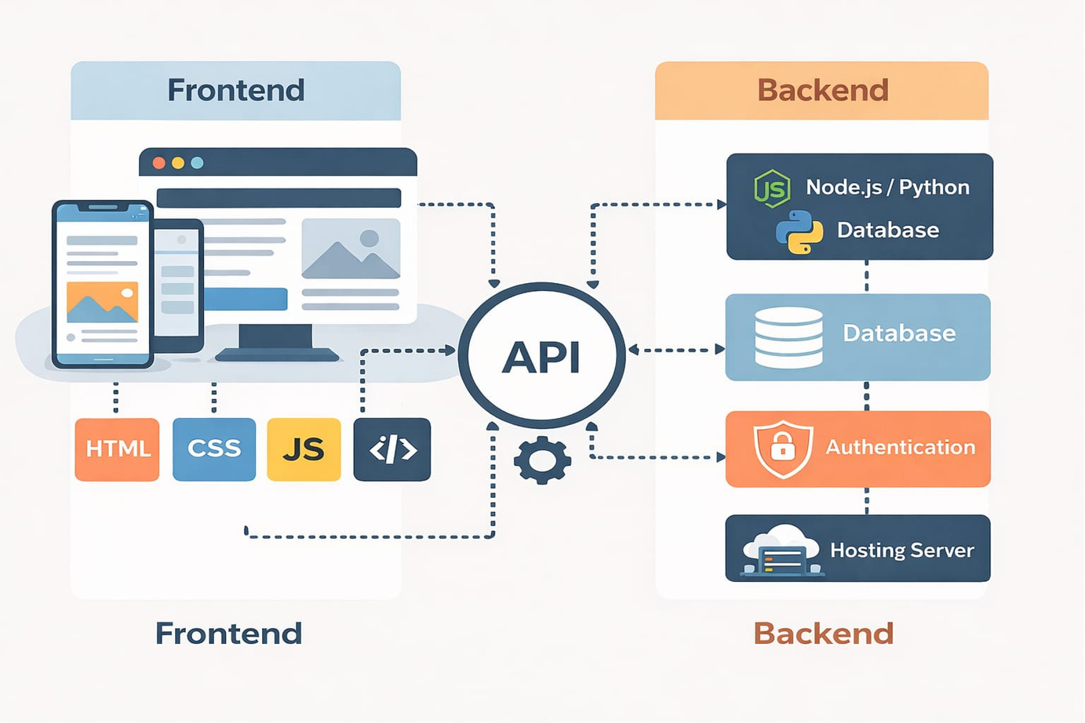

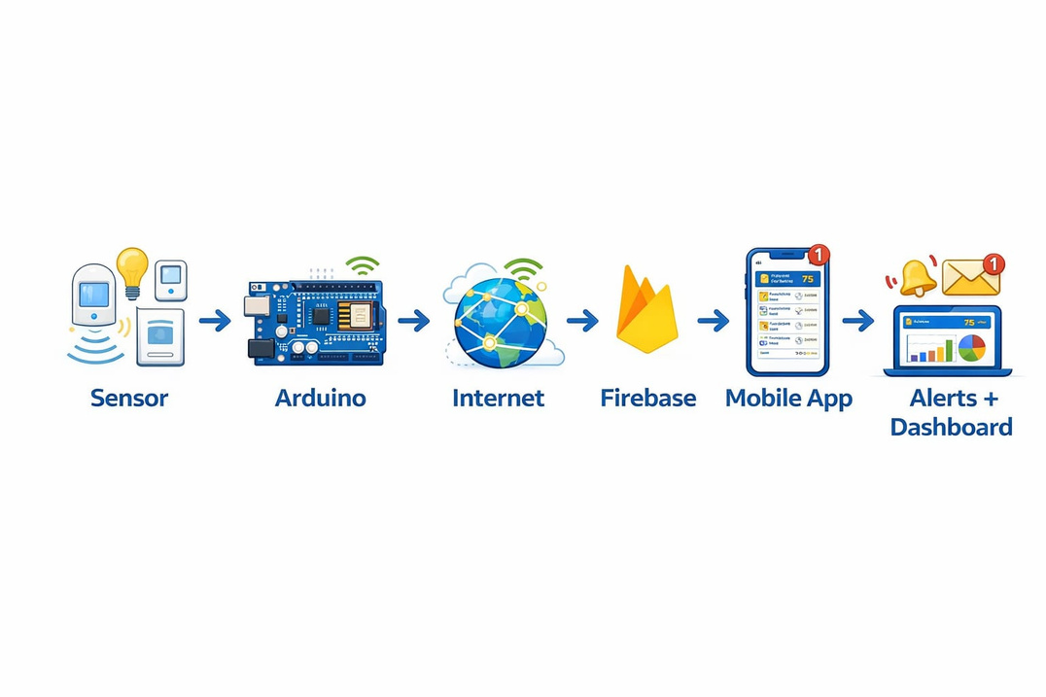
ARCHITECTURE:

Slide 6

TARGET MARKET
Government marine authorities
Coastal management agencies
Environmental organizations (NGOs)
MARKET SIZE ANALYSIS:
1. TOTAL ADDRESSABLE MARKET (TAM)
THE GLOBAL SMART SYSTEMS / SMART BUILDING MARKET IS ABOUT $140+ BILLION (2025)
2.SERVICEABLE AVAILABLE MARKET (SAM)
APPROX 40–50% OF TAM
≈ $60 – $70 BILLION
3.SERVICEABLE OBTAINABLE MARKET (SOM)
TYPICALLY 1% – 6% OF SAM
≈ $0.6 – $3 BILLION

Slide 7

POTENTIAL OUTCOMES
Reduced marine pollution through early detection
Protection of marine biodiversity
Controlled and sustainable tourism
Reduced overuse of marine resources
Faster response from authorities
Increased public participation and awareness
Real-time monitoring of ocean conditions
Data-driven decision making
Improved conservation strategies

Slide 8
THANK YOU

